Slide 1

Web Technology
JAVA PROGRAMMING
Unit IV
Multi Threading and Collections
KLE BCA Belgaum

Slide 2
Web Technology
JAVA PROGRAMMING
Multithreading in Java
Multithreading in Java is a process of executing multiple threads simultaneously.
A thread is a lightweight sub-process, the smallest unit of processing. Multiprocessing and multithreading, both are used to achieve multitasking.
However, we use multithreading than multiprocessing because threads use a shared memory area. They don't allocate separate memory area so saves memory, and context-switching between the threads takes less time than process.
KLE BCA Belgaum

Slide 3
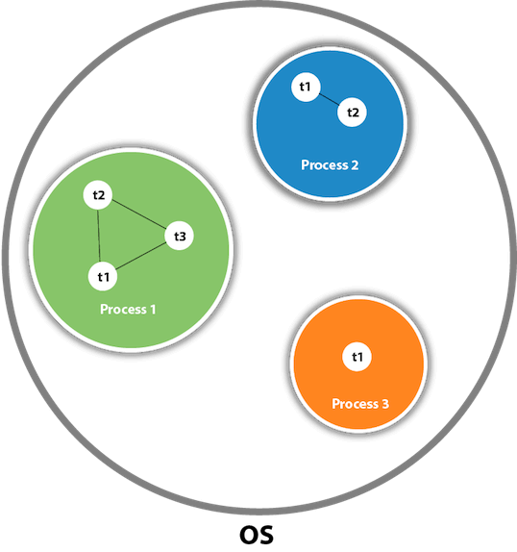
Web Technology
JAVA PROGRAMMING
What is Thread in java
A thread is a lightweight subprocess, the smallest unit of processing. It is a separate path of execution.
Threads are independent. If there occurs exception in one thread, it doesn't affect other threads. It uses a shared memory area.
KLE BCA Belgaum

Slide 4
Web Technology
JAVA PROGRAMMING
Java Thread class
Java provides Thread class to achieve thread programming. Thread class provides constructors and methods to create and perform operations on a thread. Thread class extends Object class and implements Runnable interface.
KLE BCA Belgaum

Slide 5
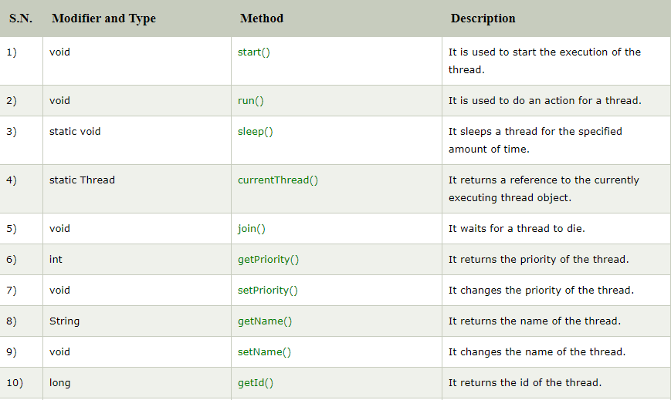
Web Technology
JAVA PROGRAMMING
KLE BCA Belgaum

Slide 6
Web Technology
JAVA PROGRAMMING
Life cycle of a Thread (Thread States)
A thread can be in one of the five states. According to sun, there is only 4 states in thread life cycle in java new, runnable, non-runnable and terminated. There is no running state.
But for better understanding the threads, we are explaining it in the 5 states.
The life cycle of the thread in java is controlled by JVM. The java thread states are as follows:
New
Runnable
Running
Non-Runnable (Blocked)
Terminated
KLE BCA Belgaum

Slide 7
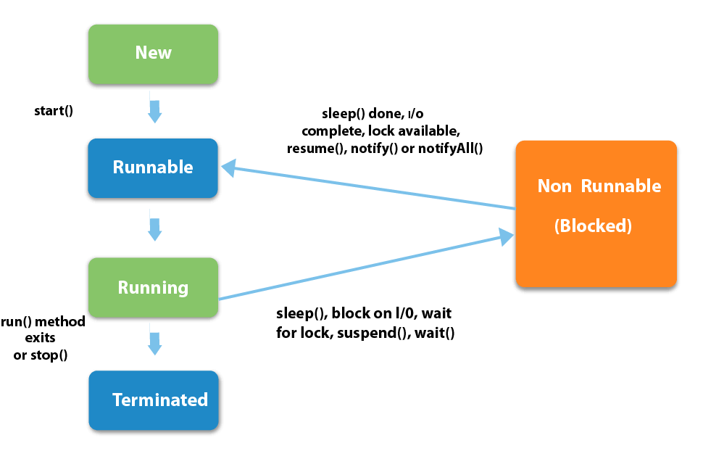
Web Technology
JAVA PROGRAMMING
KLE BCA Belgaum

Slide 8
Web Technology
JAVA PROGRAMMING
New Thread: When a new thread is created, it is in the new state. The thread has not yet started to run when thread is in this state. When a thread lies in the new state, it’s code is yet to be run and hasn’t started to execute.
Runnable State: A thread that is ready to run is moved to runnable state. In this state, a thread might actually be running or it might be ready run at any instant of time. It is the responsibility of the thread scheduler to give the thread, time to run.
Blocked/Waiting state:When a thread is temporarily inactive, then it’s in one of the following states:
Blocked
Waiting
KLE BCA Belgaum

Slide 9
Web Technology
JAVA PROGRAMMING
For example, when a thread is waiting for I/O to complete, it lies in the blocked state. It’s the responsibility of the thread scheduler to reactivate and schedule a blocked/waiting thread. A thread in this state cannot continue its execution any further until it is moved to runnable state. Any thread in these states does not consume any CPU cycle.
Timed Waiting: A thread lies in timed waiting state when it calls a method with a time out parameter. A thread lies in this state until the timeout is completed or until a notification is received. For example, when a thread calls sleep or a conditional wait, it is moved to a timed waiting state.
KLE BCA Belgaum

Slide 10
Web Technology
JAVA PROGRAMMING
Terminated State: A thread terminates because of either of the following reasons:
Because it exists normally. This happens when the code of thread has entirely executed by the program.
Because there occurred some unusual erroneous event, like segmentation fault or an unhandled exception.
A thread that lies in a terminated state does no longer consumes any cycles of CPU.
KLE BCA Belgaum

Slide 11
Web Technology
JAVA PROGRAMMING
How to create thread
There are two ways to create a thread:
By extending Thread class
By implementing Runnable interface.
Starting a thread:
start() method of Thread class is used to start a newly created thread. It performs following tasks:A new thread starts(with new callstack).
The thread moves from New state to the Runnable state.
When the thread gets a chance to execute, its target run() method will run.
KLE BCA Belgaum

Slide 12
Web Technology
JAVA PROGRAMMING
Java Thread Example by extending Thread class
class Multi extends Thread
{
public void run()
{
System.out.println("thread is running...");
}
public static void main(String args[])
{
Multi t1=new Multi();
t1.start();
}
}
KLE BCA Belgaum

Slide 13
Web Technology
JAVA PROGRAMMING
2) Java Thread Example by implementing Runnable interface
class Multi3 implements Runnable
{
public void run()
{
System.out.println("thread is running...");
}
public static void main(String args[])
{
Multi3 m1=new Multi3();
Thread t1 =new Thread(m1);
t1.start();
}
}
KLE BCA Belgaum

Slide 14
Web Technology
JAVA PROGRAMMING
Extending the Thread Methods
class priority extends Thread
{
public void run()
{
System.out.println(Thread.currentThread().getName()+"Priority is:"+Thread.currentThread().getPriority());
}
}
public class pgm24
{
public static void main(String args[])
{
priority m1=new priority();
priority m2=new priority();
priority m3=new priority();
KLE BCA Belgaum

Slide 15
Web Technology
JAVA PROGRAMMING
m1.setPriority(Thread.MIN_PRIORITY);
m2.setPriority(Thread.MAX_PRIORITY);
m3.setPriority(Thread.NORM_PRIORITY);
m1.start();
m2.start();
m3.start();
}
}
OUTPUT:
Thread-0Priority is:1
Thread-2Priority is:5
Thread-1Priority is:10
KLE BCA Belgaum

Slide 16
Web Technology
JAVA PROGRAMMING
Priority of a Thread (Thread Priority):
Each thread have a priority. Priorities are represented by a number between 1 and 10. In most cases, thread schedular schedules the threads according to their priority (known as preemptive scheduling).
But it is not guaranteed because it depends on JVM specification that which scheduling it chooses.
3 constants defined in Thread class:
public static int MIN_PRIORITY
public static int NORM_PRIORITY
public static int MAX_PRIORITY
Default priority of a thread is 5 (NORM_PRIORITY). The value of MIN_PRIORITY is 1 and the value of MAX_PRIORITY is 10.
KLE BCA Belgaum

Slide 17
Web Technology
JAVA PROGRAMMING
public static int MIN_PRIORITY: This is minimum priority that a thread can have. Value for this is 1.
public static int NORM_PRIORITY: This is default priority of a thread if do not explicitly define it. Value for this is 5.
public static int MAX_PRIORITY: This is maximum priority of a thread. Value for this is 10.
Get and Set Thread Priority:
public final int getPriority(): java.lang.Thread.getPriority() method returns priority of given thread.
public final void setPriority(int newPriority): java.lang.Thread.setPriority() method changes the priority of thread to the value newPriority. This method throws IllegalArgumentException if value of parameter newPriority goes beyond minimum(1) and maximum(10) limit.
KLE BCA Belgaum

Slide 18
Web Technology
JAVA PROGRAMMING
Example of priority of a Thread:
class TestMultiPriority1 extends Thread
{
public void run()
{
System.out.println("running thread name is:"+Thread.currentThread().getName());
System.out.println("running thread priority is:"+Thread.currentThread().getPriority());
}
public static void main(String args[])
{
TestMultiPriority1 m1=new TestMultiPriority1();
TestMultiPriority1 m2=new TestMultiPriority1();
m1.setPriority(Thread.MIN_PRIORITY);
m2.setPriority(Thread.MAX_PRIORITY);
m1.start();
m2.start();
}}
}
KLE BCA Belgaum

Slide 19
Web Technology
JAVA PROGRAMMING
Synchronization
When we start two or more threads within a program, there may be a situation when multiple threads try to access the same resource and finally they can produce unforeseen result due to concurrency issues.
For example, if multiple threads try to write within a same file then they may corrupt the data because one of the threads can override data or while one thread is opening the same file at the same time another thread might be closing the same file.
So there is a need to synchronize the action of multiple threads and make sure that only one thread can access the resource at a given point in time. This is implemented using a concept called monitors.
KLE BCA Belgaum

Slide 20
Web Technology
JAVA PROGRAMMING
Each object in Java is associated with a monitor, which a thread can lock or unlock. Only one thread at a time may hold a lock on a monitor.
Java programming language provides a very handy way of creating threads and synchronizing their task by using synchronized blocks
You keep shared resources within this block. Following is the general form of the synchronized statement −
Syntax
synchronized(objectidentifier)
{
// Access shared variables and other shared resources
}
KLE BCA Belgaum

Slide 21
Web Technology
JAVA PROGRAMMING
Understanding the problem without Synchronization
class Table
{
void printTable(int n)
{
//method not synchronized
for(int i=1;i<=5;i++)
{
System.out.println(n*i);
try
{
Thread.sleep(400);
}
catch(Exception e)
{
System.out.println(e);}
}
}
} }
KLE BCA Belgaum

Slide 22
Web Technology
JAVA PROGRAMMING
class MyThread1 extends Thread
{
Table t;
MyThread1(Table t)
{
this.t=t;
}
public void run()
{
t.printTable(5);
}
}
KLE BCA Belgaum

Slide 23
Web Technology
JAVA PROGRAMMING
class MyThread2 extends Thread
{
Table t;
MyThread2(Table t)
{
this.t=t;
}
public void run()
{
t.printTable(100);
}
}
KLE BCA Belgaum

Slide 24
Web Technology
JAVA PROGRAMMING
class TestSynchronization1
{
public static void main(String args[])
{
Table obj = new Table();//only one object
MyThread1 t1=new MyThread1(obj);
MyThread2 t2=new MyThread2(obj);
t1.start();
t2.start();
}
}
Output: 5 100 10 200 15 300 20 400 25 500
KLE BCA Belgaum

Slide 25
Web Technology
JAVA PROGRAMMING
Java synchronized method
If you declare any method as synchronized, it is known as synchronized method.
Synchronized method is used to lock an object for any shared resource.
When a thread invokes a synchronized method, it automatically acquires the lock for that object and releases it when the thread completes its task.
KLE BCA Belgaum

Slide 26
Web Technology
JAVA PROGRAMMING
//Program of synchronized method by using annonymous class
class Table
{
synchronized void printTable(int n)
{
//synchronized method
for(int i=1;i<=5;i++)
{
System.out.println(n*i);
try
{
Thread.sleep(400);
}
catch(Exception e)
{
System.out.println(e);}
}
}
} }
KLE BCA Belgaum

Slide 27
Web Technology
JAVA PROGRAMMING
class MyThread1 extends Thread
{
Table t;
MyThread1(Table t)
{
this.t=t;
}
public void run()
{
t.printTable(5);
}
}
KLE BCA Belgaum

Slide 28
Web Technology
JAVA PROGRAMMING
class MyThread2 extends Thread
{
Table t;
MyThread2(Table t)
{
this.t=t;
}
public void run()
{
t.printTable(100);
}
}
KLE BCA Belgaum

Slide 29
Web Technology
JAVA PROGRAMMING
class TestSynchronization1
{
public static void main(String args[])
{
Table obj = new Table();//only one object
MyThread1 t1=new MyThread1(obj);
MyThread2 t2=new MyThread2(obj);
t1.start();
t2.start();
}
}
Output: 5 10 15 20 25 100 200 300 400 500
KLE BCA Belgaum

Slide 30
Web Technology
JAVA PROGRAMMING
Implementing Runnable interface
There are two ways to create a thread:
By extending Thread class
By implementing Runnable interface.
Runnable interface:
The Runnable interface should be implemented by any class whose instances are intended to be executed by a thread.
Runnable interface have only one method named run().public void run(): is used to perform action for a thread.
KLE BCA Belgaum

Slide 31
Web Technology
JAVA PROGRAMMING
class Multi3 implements Runnable
{
public void run()
{
System.out.println("thread is running...");
}
public static void main(String args[])
{
Multi3 m1=new Multi3();
Thread t1 =new Thread(m1);
t1.start();
}
}
KLE BCA Belgaum

Slide 32
Web Technology
JAVA PROGRAMMING
If you are not extending the Thread class,your class object would not be treated as a thread object.So you need to explicitely create Thread class object.We are passing the object of your class that implements Runnable so that your class run() method may execute.
KLE BCA Belgaum

Slide 33
Web Technology
JAVA PROGRAMMING
Thread Sleep () Method
Thread Class is a class that is basically a thread of execution of the programs. It is present in Java.lang package. Thread class contains the Sleep() method.
The sleep() method is used to stop the execution of the current thread(whichever might be executing in the system) for a specific duration of the time and after that time duration gets over, the thread which is executing earlier starts to execute again.
KLE BCA Belgaum

Slide 34
Important Point Regarding Thread.sleep() Method:
Method Whenever Thread.sleep() functions to execute, it always pauses the current thread execution.
If any other thread interrupts when the thread is sleeping, then InterruptedException will be thrown.
If the system is busy, then the actual time the thread will sleep will be more as compared to that passed while calling the sleep method and if the system has less load, then the actual sleep time of the thread will be close to that passed while calling sleep() method.

Slide 35
class TestSleepMethod1 extends Thread{
public void run(){
for(int i=1;i<5;i++){
// the thread will sleep for the 500 milli seconds
try {
Thread.sleep(500);
}
catch(InterruptedException e)
{
System.out.println(e);
}
System.out.println(i);
}
}
public static void main(String args[]){
TestSleepMethod1 t1=new TestSleepMethod1();
TestSleepMethod1 t2=new TestSleepMethod1();
t1.start();
t2.start();
}
Thread Sleep () Method Pgm

Slide 36
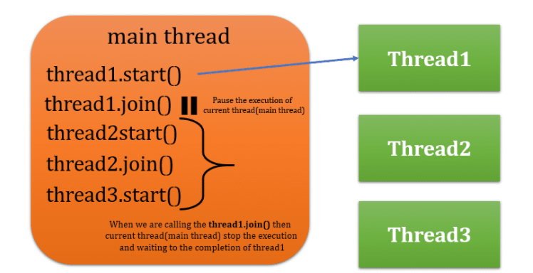
Thread Join() Method
join(): When the join() method is invoked, the current thread stops its execution and the thread goes into the wait state. The current thread remains in the wait state until the thread on which the join() method is invoked has achieved its dead state. If interruption of the thread occurs, then it throws the InterruptedException.
Syntax : public final void join() used As T1.join();

Slide 37
// A Java program for understanding
// the joining of threads
// import statement
import java.io.*;
// The ThreadJoin class is the child class of the class Thread
class ThreadJoin extends Thread
{
// overriding the run method
public void run()
{
for (int j = 0; j < 2; j++)
{
try
{
// sleeping the thread for 300 milli seconds
Thread.sleep(300);
System.out.println("The current thread name is: " + Thread.currentThread().getName());
}
// catch block for catching the raised exception
catch(Exception e)
{
System.out.println("The exception has been caught: " + e);
}
System.out.println( j );
}
}
}

Slide 38
public class ThreadJoinExample
{
// main method
public static void main (String argvs[])
{
// creating 3 threads
ThreadJoin th1 = new ThreadJoin();
ThreadJoin th2 = new ThreadJoin();
ThreadJoin th3 = new ThreadJoin();

Slide 39
// thread th1 starts
th1.start();
// starting the second thread after when the first thread th1 has ended or died.
try
{
System.out.println("The current thread name is: "+ Thread.currentThread().getName());
// invoking the join() method
th1.join();
}
// catch block for catching the raised exception
catch(Exception e)
{
System.out.println("The exception has been caught " + e);
}
}

Slide 40
// thread th2 starts
th2.start();
// starting the th3 thread after when the thread th2 has ended or died.
try
{
System.out.println("The current thread name is: " + Thread.currentThread().getName());
th2.join();
}
// catch block for catching the raised exception
catch(Exception e)
{
System.out.println("The exception has been caught " + e);
}
// thread th3 starts
th3.start();
}

Slide 41
Java Collections
The Collection in Java is a framework that provides an architecture to store and manipulate the group of objects.
Java Collections can achieve all the operations that you perform on a data such as searching, sorting, insertion, manipulation, and deletion.
Java Collection means a single unit of objects. Java Collection framework provides many interfaces (Set, List, Queue, Deque) and classes (ArrayList,Vector, LinkedList, PriorityQueue, HashSet, LinkedHashSet, TreeSet).

Slide 42
Java Collections
What is Collection in Java
A Collection represents a single unit of objects, i.e., a group.
What is a framework in Java
It provides readymade architecture.
It represents a set of classes and interfaces.
It is optional.
What is Collection framework
The Collection framework represents a unified architecture for storing and manipulating
a group of objects. It has:
Interfaces and its implementations, i.e., classes
Algorithm

Slide 43
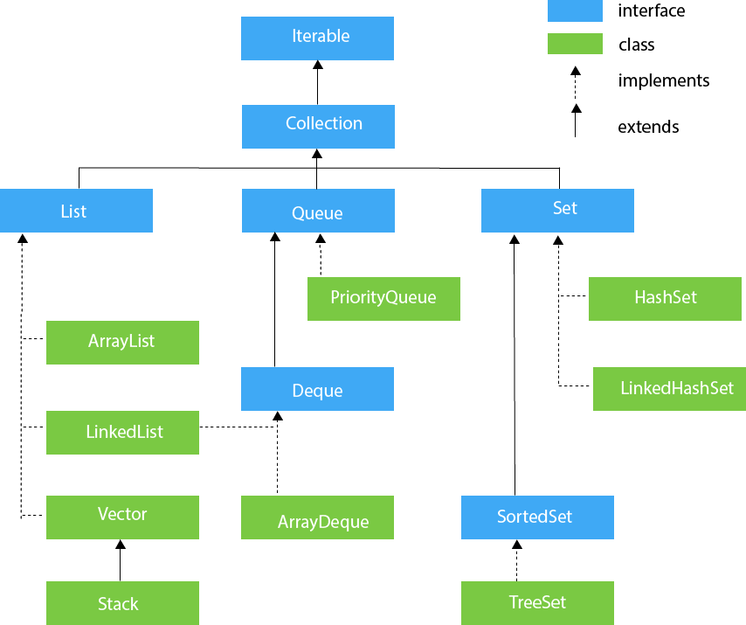
Hierarchy of Collection Framework
The java.util package contains all the classes and interfaces for the Collection framework.

Slide 44
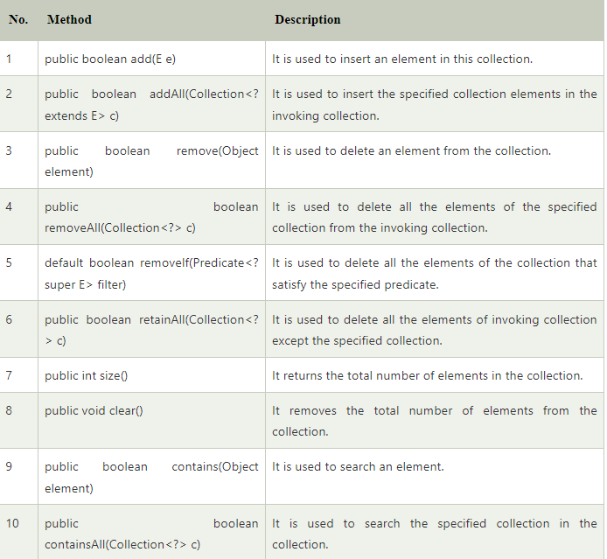
Methods of Collection interface

Slide 45
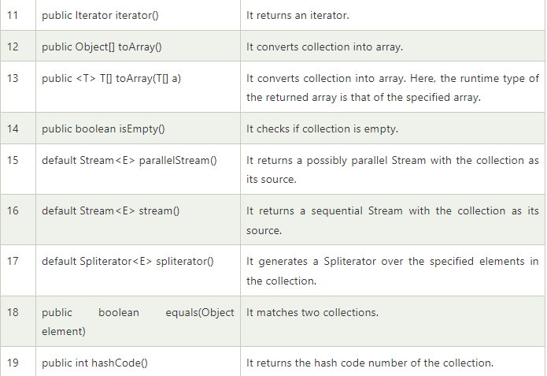
Methods of Collection interface

Slide 46
Iterator interface
Iterator interface
Iterator interface provides the facility of iterating the elements in a forward direction only.
Methods of Iterator interface

Slide 47
Iterable Interface
Iterable Interface
The Iterable interface is the root interface for all the collection classes.
The Collection interface extends the Iterable interface and therefore all the subclasses of Collection interface also implement the Iterable interface.
It contains only one abstract method. i.e.,
Iterator<T> iterator()
It returns the iterator over the elements of type T.

Slide 48
Collection Interface
The Collection interface is the interface which is implemented by all the classes in the collection framework.
It declares the methods that every collection will have. In other words, we can say that the Collection interface builds the foundation on which the collection framework depends.
Some of the methods of Collection interface are Boolean add ( Object obj), Boolean addAll ( Collection c), void clear(), etc. which are implemented by all the subclasses of Collection interface.

Slide 49
List Interface
List interface is the child interface of Collection interface. It inhibits a list type data structure in which we can store the ordered collection of objects. It can have duplicate values.
List interface is implemented by the classes ArrayList, LinkedList, Vector, and Stack.
To instantiate the List interface, we must use :
List <data-type> list1= new ArrayList();
List <data-type> list2 = new LinkedList();
List <data-type> list3 = new Vector();
List <data-type> list4 = new Stack();

Slide 50
ArrayList
The ArrayList class implements the List interface. It uses a dynamic array to store the duplicate element of different data types.
The ArrayList class maintains the insertion order and is non-synchronized. The elements stored in the ArrayList class can be randomly accessed. Consider the following example.
import java.util.*;
class TestJavaCollection1{
public static void main(String args[]){
ArrayList<String> list=new ArrayList<String>();//Creating arraylist
list.add("Ravi");//Adding object in arraylist
list.add("Vijay");
list.add("Ravi");
list.add("Ajay");
//Traversing list through Iterator
Iterator itr=list.iterator();
while(itr.hasNext()){
System.out.println(itr.next());
} } }

Slide 51
LinkedList
LinkedList implements the Collection interface. It uses a doubly linked list internally to store the elements. It can store the duplicate elements.
It maintains the insertion order and is not synchronized. In LinkedList, the manipulation is fast because no shifting is required.
import java.util.*;
public class TestJavaCollection2{
public static void main(String args[]){
LinkedList<String> al=new LinkedList<String>();
al.add("Ravi");
al.add("Vijay");
al.add("Ravi");
al.add("Ajay");
Iterator<String> itr=al.iterator();
while(itr.hasNext()){
System.out.println(itr.next());
} } }

